Slide 1
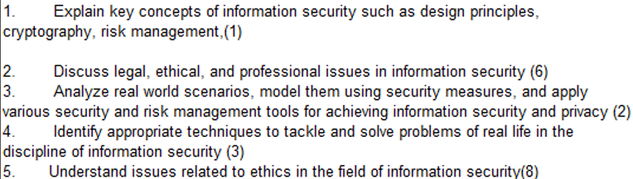
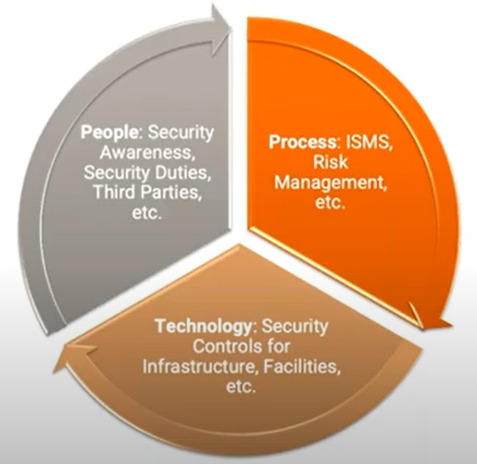
CS 3002 Information Security
Fall 2022
Week # 5 – Lecture # 13, 14, 15
23rd, 24th, 25th Safar ul Muzaffar, 1444
20th , 22nd , 23rd September 2022
Dr. Nadeem Kafi Khan

Slide 2
Lecture # 13 - LAB
Role Based Access Control (RBAC) - See Week # 5 post on GCR
Quiz # 1

Slide 3
Lecture # 14
Means of Authentication
Password based authentication
The vulnerabilities of Passwords
Unix Password scheme
Password cracking for user-chosen passwords
Password selection strategies

Slide 4
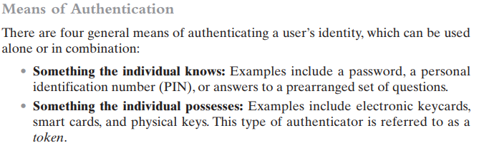
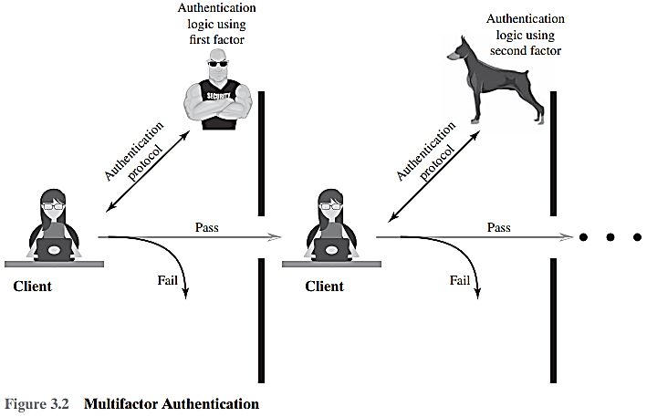

Multifactor authentication refers to the use of more than one of the authentication means in the preceding list. Implementations that use two factors are considered to be stronger than those that use only one factor; systems that incorporate three factors are stronger than systems that only incorporate two of the factors, and so on.

Slide 5
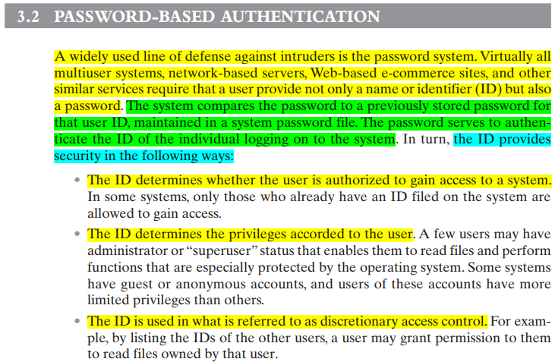

Slide 6
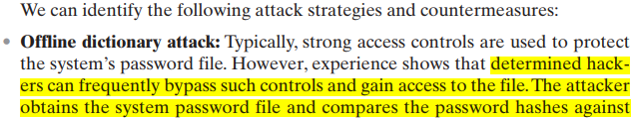
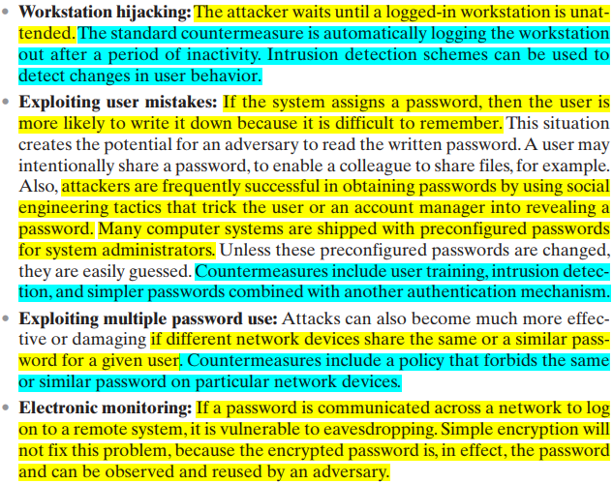
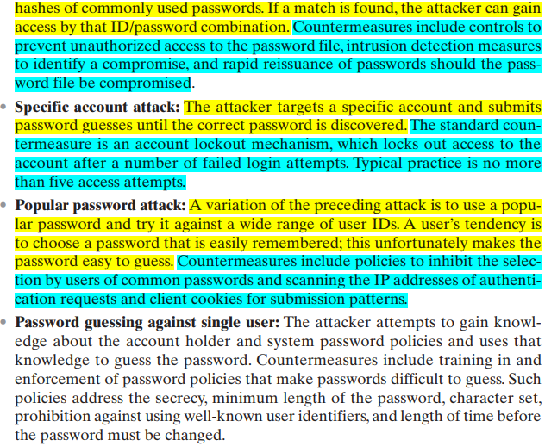

Slide 7
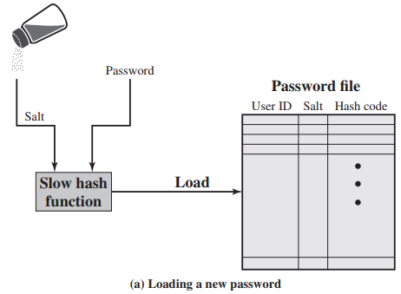
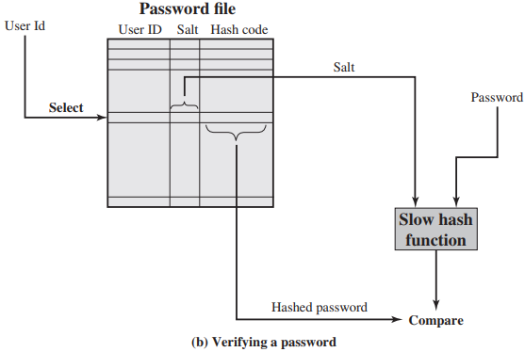

Slide 8
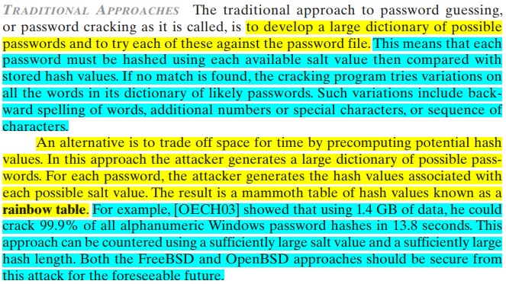

Slide 9
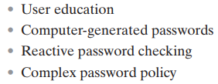

Slide 10
Lecture # 15
Token based Authentication
Type of card used as Token
Smart Cards
Smart Card/Reader Exchange
eID cards
Electronic Functions and Data for eID cards
User Authentication with eIDs
Biometric Authentication
Physical characteristics used in biometric authentication
A generic biometric system

Slide 11
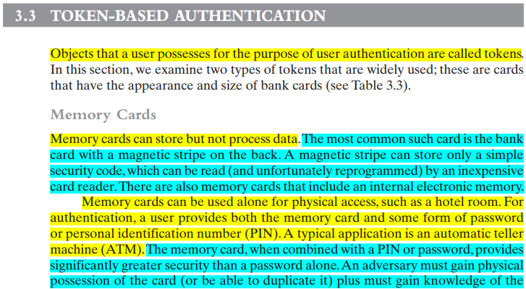
Read about potential drawbacks from the book

Slide 12
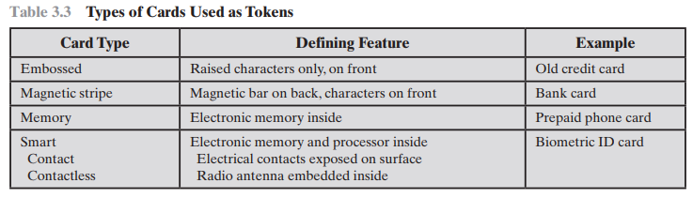

Slide 13
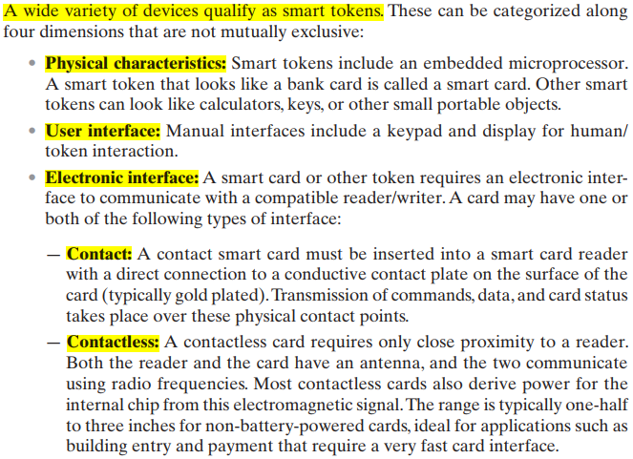
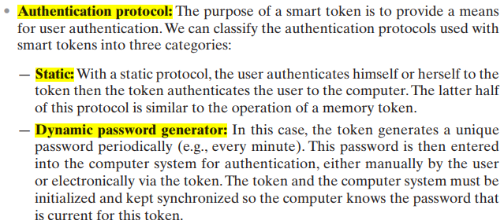


Slide 14
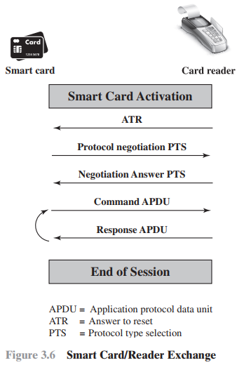
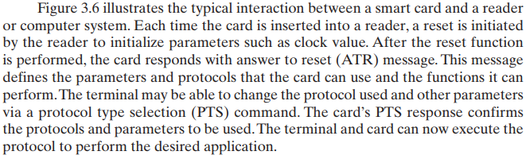

Slide 15
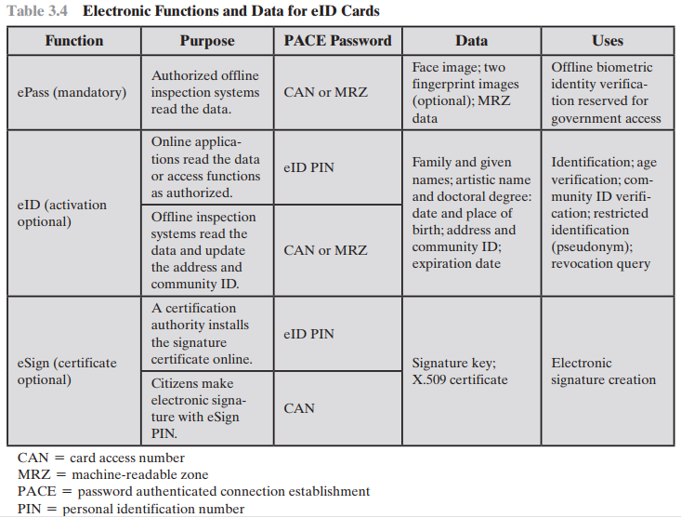

Slide 16
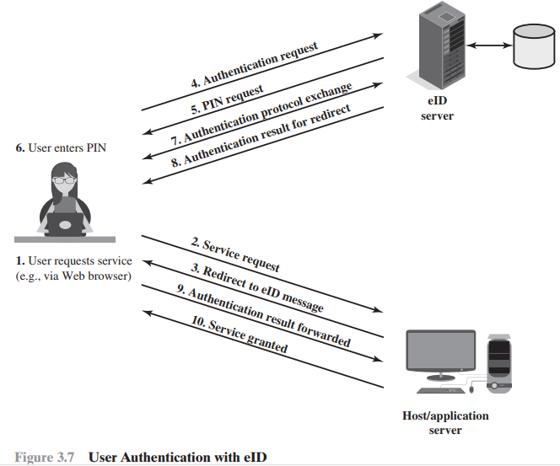
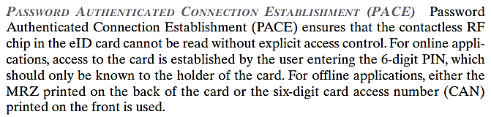

Slide 17
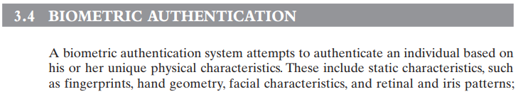
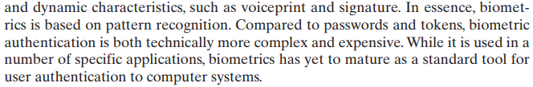

Slide 18
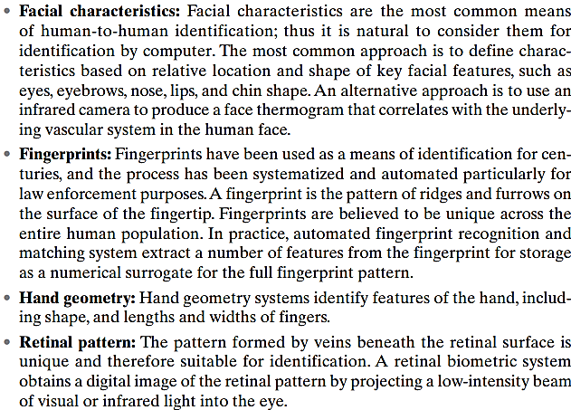
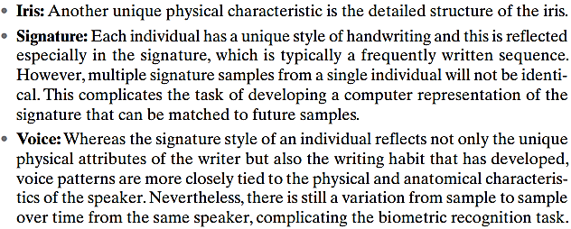
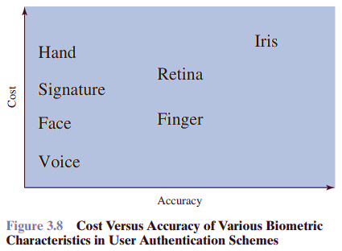

Slide 19
